Slide 1
Classifying Poisonous Mushrooms Using Machine Learning
Team C
Andrew Taylor
Pierre Augustamar
Abtin Ardeshiri
Bradley Lignoski

Slide 2
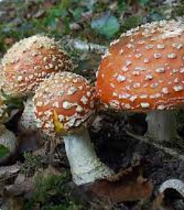


Problem Statement
Many people like to go foraging for wild mushrooms, and some like to eat them, but a small proportion of mushrooms are poisonous, and can even be deadly. Identifying which is which usually involves a large reference from a reputable source, and can be perilous and time consuming conducted manually. What if there was a way to use data and machine learning to create a classification to accurately identify and avoid poisonous mushroom based on some observed characteristics?
Popular culture is not reliable for this wisdom. For example, the fly agaric is a mushroom found in the popular Super Mario Bros. video games. Super Mario eats this mushroom all the time, but it could be lethal if eaten by humans. Kids may not know. How should we be better informed? This is where the Mushroom Dataset comes in handy…
Careful, Mario!

Slide 3
Objective: Identify Poisonous Mushrooms
The consequences of consuming the wrong mushroom can be severe, ranging from serious illness to potentially fatal outcomes. Given the high stakes, our primary objective is to develop a classification system capable of accurately identifying all harmful mushrooms, ensuring that none are misclassified as safe. To achieve this, we aim to minimize false negatives to zero, as even a single harmful mushroom slipping through the system could have disastrous consequences.
By framing the problem this way, we focus on what truly matters—safety and risk mitigation. While false positives may result in some safe mushrooms being unnecessarily avoided, the cost of such errors is negligible compared to the dangers posed by false negatives. This approach underscores the importance of erring on the side of caution, aligning the system's design with the critical need to protect individuals from harm.
As a reminder of how critical it is to get this algorithm right, recent events highlight the stakes. An incident in Pennsylvania involving toxic mushrooms has caused serious health concerns, demonstrating the devastating impact of misidentification. You can read more about the case here: The Guardian - Toxic Mushrooms in Pennsylvania
This underscores the critical importance of designing a machine learning algorithm that prioritizes recall and minimizes errors, as the consequences of misclassification can be life-threatening.

Slide 4
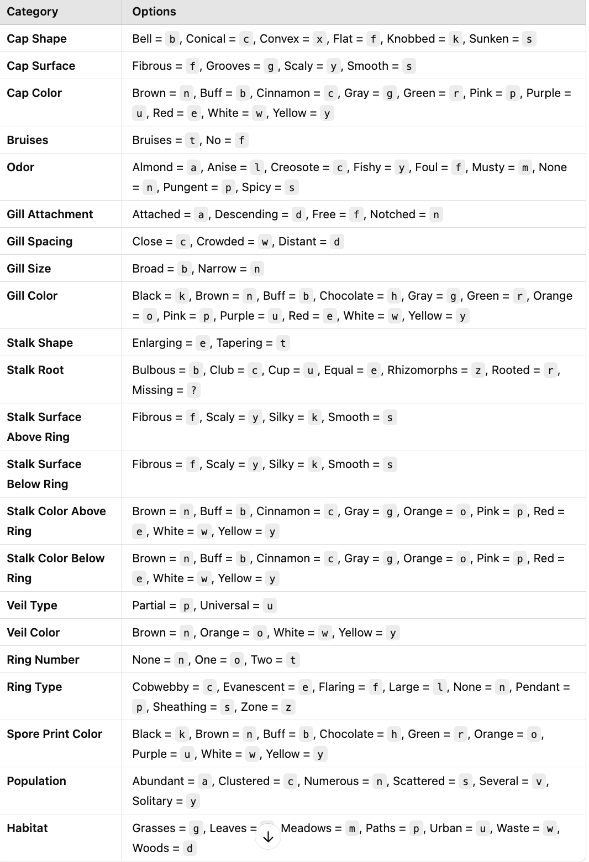
The Mushroom Dataset
This dataset has been a hallmark of binary classification since 1987, including 23 species of gilled mushrooms in the Agaricus and Lepiota families drawn as a subset from the Audubon Society Field Guide to North American Mushrooms.
Each species has a definite classification as definitely edible, definitely poisonous, or unknown and not recommended (the dataset considers these as poisonous).
There is no simple rule on one or two attributes which identifies the poisonous mushrooms, so a complex classification must be created. Out of 8,124 observations, 52% are considered edible. Since the classes are roughly balanced, stratified sampling, upsampling or SMOTE are unneeded.

Slide 5
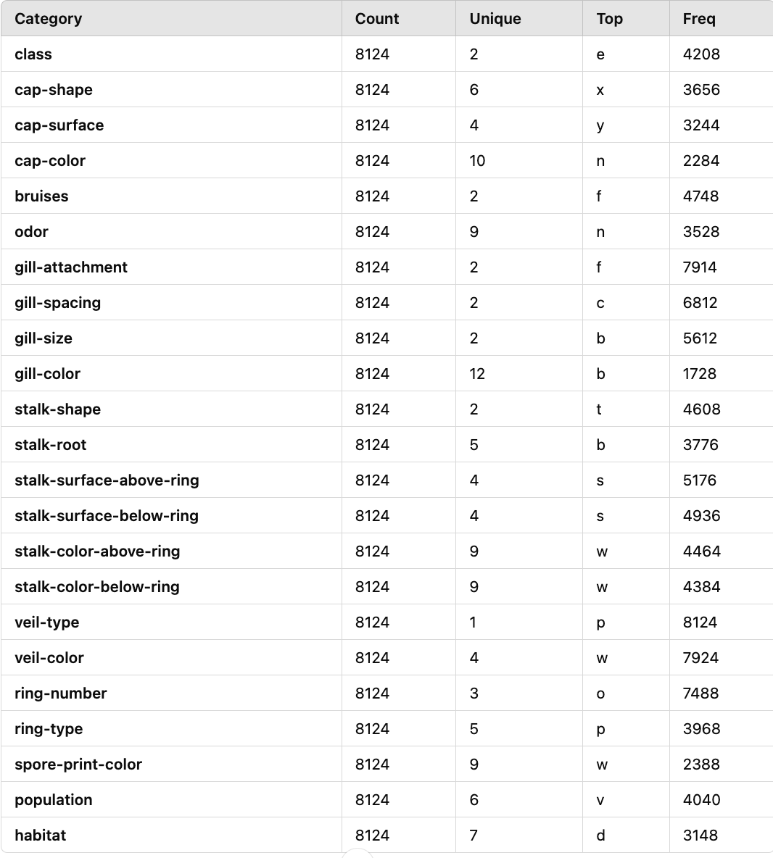
Categorical Feature Distribution for Mushroom Classification
The table presents categorical features with varying levels of uniqueness and frequency in a mushroom dataset. Key insights include:
Feature Uniformity: Some features, like "veil-type", have only one unique value, while others, like "gill-color" and "spore-print-color", have more diversity, indicating their potential importance for classification.
High Frequency Values: Certain categories dominate, such as "gill-attachment" (f), which could play a significant role in classification.
Appearance and Environment: Features like "cap-color", "stalk-root", and "habitat" show varied categories, suggesting they are important for distinguishing mushroom types.
In summary, the dataset has both highly informative features and some with limited variation, requiring careful evaluation for predictive modeling.

Slide 6
Data Preprocessing
Our dataset did not exhibit common issues, so minimal preprocessing was required. Specifically, we did not encounter:
- Rows or columns with missing data: Instances where some values were left blank or undefined.
- Outliers: Extreme values that could distort the analysis or model training.
- Repeated data: Duplicate rows or records that could bias the results.
- Private data requiring anonymization: Sensitive information that might need to be hidden or replaced for privacy.
- Unlabeled entries: Data points that lacked the necessary labels for supervised learning. The data was already labeled, as shown in the previous slide, so no additional labeling was necessary. Since the dataset was obtained from Kaggle, it was preprocessed and ready for use. Nonetheless, we performed a thorough check to ensure it was suitable for model training.

Slide 7
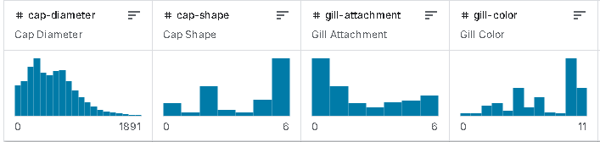
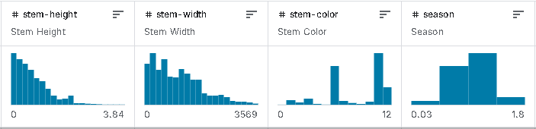
Exploratory Data Analysis
These are the top 8 features after z-score normalization, and feature selection. As you see these features exhibit a variety of distributions from which to build a classification.

Slide 8
Proof Of Concept - Mushroom Classification
Goal:
Perform a side-by-side comparison of multiple machine learning algorithms to accurately classify mushrooms as edible or poisonous.
Assess each model's ability to handle non-linear relationships and determine feature importance, helping identify the most effective approach for classification.
Platform:
Azure Notebooks - Leverage cloud resources to streamline the experimentation process, access powerful compute for model training, and manage data efficiently within a collaborative environment.
Output:
Generate a comparison table that displays key performance metrics, such as Accuracy, ROC AUC, Recall, Precision, and F1 Score for each model.
Use the findings to determine which model balances performance and interpretability for this classification task

Slide 9
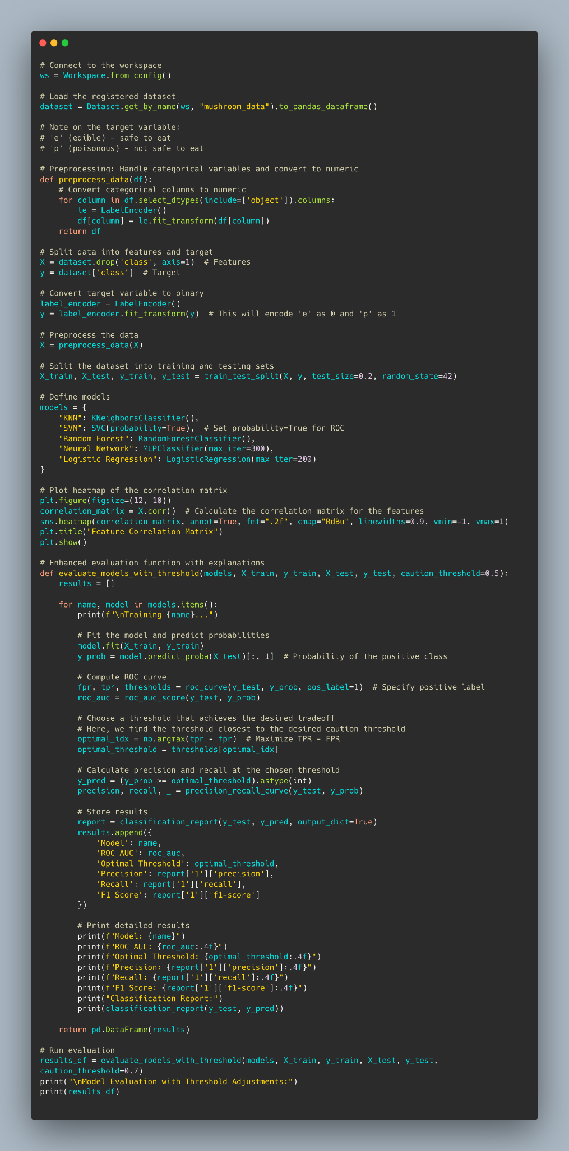
Proof of Concept: Code Sample
Mushroom Classification Model Pipeline Pseudocode:
1. Load and preprocess data (encode categorical features, split into training and test sets)
2. Initialize models (K-Nearest Neighbors, SVM, Random Forest, Neural Network, Logistic Regression)
3. Train each model on the training dataset
4. Predict class probabilities on the test dataset
5. Convert probabilities to class labels using an optimal threshold
6. Evaluate each model using metrics (accuracy, precision, recall, ROC AUC)

Slide 10
Proof Of Concept - Experiment Models
Models Tested:
Logistic Regression
Provides a baseline accuracy for comparison and interprets linear relationships between features and the target variable. Ideal for establishing initial expectations.
Random Forest
Captures complex patterns with an ensemble of decision trees and identifies feature importance, making it highly effective for non-linear data structures.
Support Vector Machine (SVM)
Designed for binary classification with non-linear boundaries, SVM often excels at distinguishing between closely related classes with a high margin of separation.
Neural Network (MLP)
Uses a multi-layer perceptron to capture non-linear relationships, exploring the effectiveness of neural networks on a simplified architecture for interpretability and computational efficiency.

Slide 11
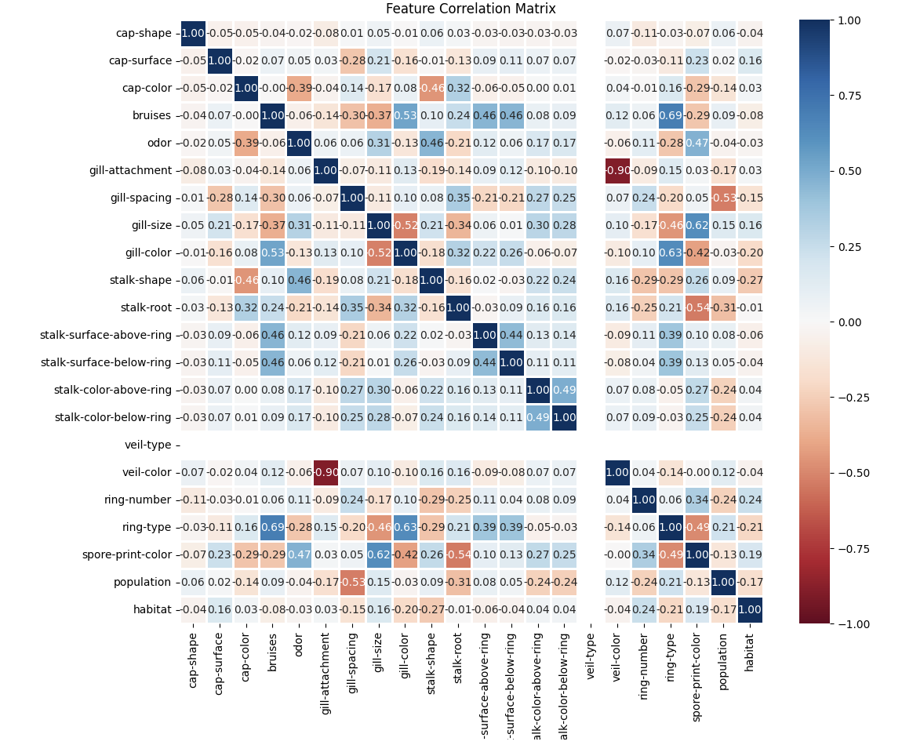
Proof of Concept - Correlation Matrix
This heatmap visualizes the correlation matrix of the mushrooms dataset.
Each square in the heatmap represents the correlation between two features. The color intensity indicates the strength of the correlation:
Dark Red: Strong negative correlation
Dark Blue: Strong positive correlation
White: No correlation or a very weak correlation.
The absence of dark blue in our matrix clears us of the problem of multicollinearity, or highly correlated features that could reduce statistical significance, interpretability and model stability.
Instead of relying on a single feature for 100% accuracy, our model achieves its performance through a combination of all the features working together.

Slide 12
Proof Of Concept - HeatMap Observations
Observations and Implications:
Based on the correlation analysis, it seems that there are no exceptionally high correlations between features that directly relate to a mushroom being poisonous. Most of the observed correlations are tied to physical and morphological characteristics that are not necessarily linked to the toxic properties of mushrooms.
This is actually beneficial for our model development! High correlations between features can lead to problems such as multicollinearity, where redundant features interfere with the model's ability to interpret relationships clearly,
By leveraging these features without the concern of multicollinearity, we can build a more robust and interpretable model to predict the poisonous nature of mushrooms. The lack of strong correlations also suggests that each feature might bring unique and independent information to the model, which could enhance its predictive power and allow for more accurate classifications.

Slide 13
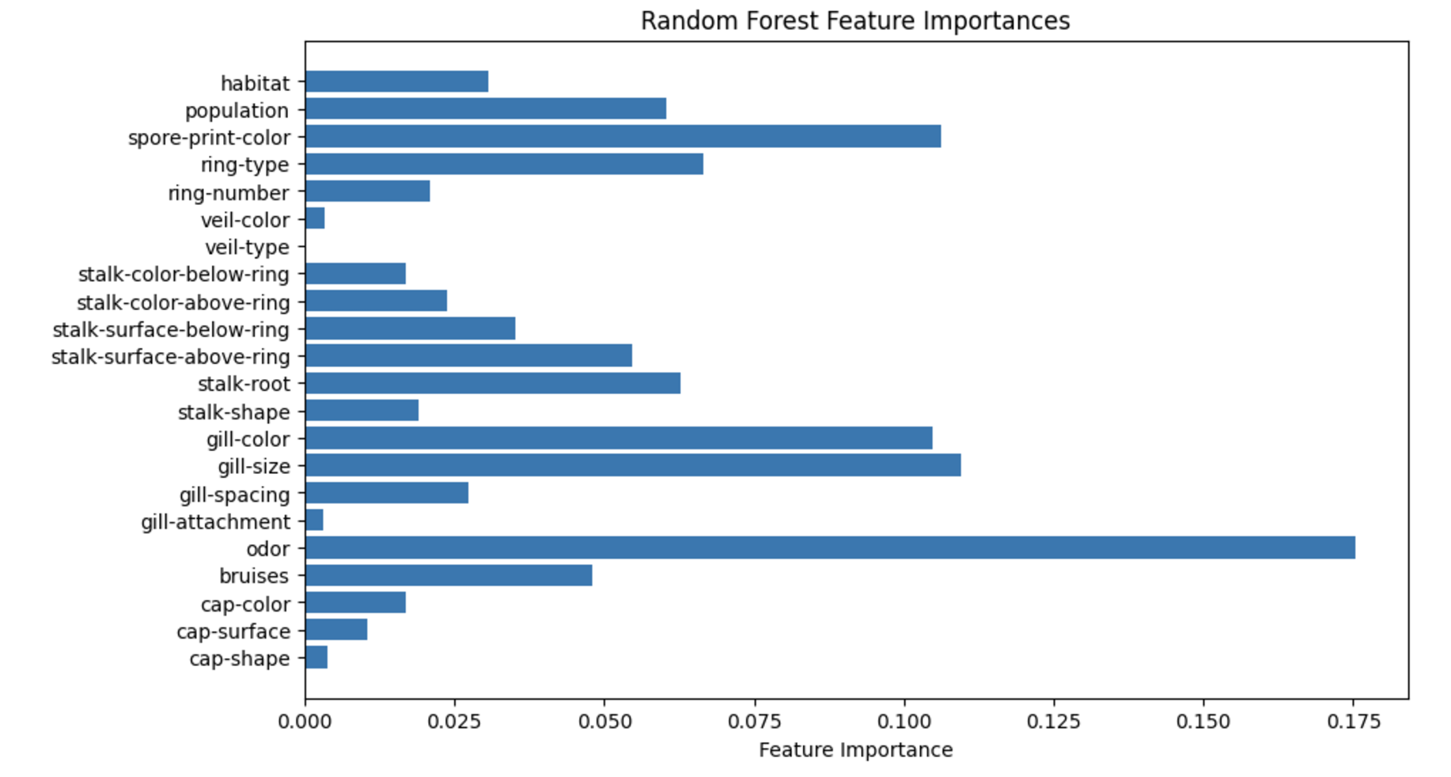
Proof Of Concept - Feature Importances
The feature importance chart generated by the Random Forest model indicates which features are most significant in predicting the target variable for the mushroom dataset. In the chart:
- Odor stands out as the most important feature, contributing the highest weight to the model's predictions. This suggests that odor is a critical factor in distinguishing between edible and poisonous mushrooms.
- Other features with notable importance include gill size, gill color, and spore print color, which also play substantial roles in classification.
- Features like veil color, gill attachment, and cap shape have minimal contribution, indicating they are less relevant to the model’s predictions.
This analysis highlights that certain physical and sensory characteristics of mushrooms are much more predictive than others, with odor being the dominant feature.

Slide 14
Proof Of Concept - Algorithm Selection
Model Training and Evaluation: We selected five models for comparison: K-Nearest Neighbors (KNN), Support Vector Machine (SVM), Random Forest, Neural Network, and Logistic Regression. Each model was trained on a subset of the dataset, and probabilities of the positive class (poisonous) were used to assess performance on test data.
Threshold Tuning and Metric Calculation: For each model, we calculated key metrics like ROC AUC, Precision, Recall, and F1 Score at optimized decision thresholds. We used the Youden's Index approach on the ROC curve to identify an ideal threshold that balanced the need for both precision (to avoid false positives) and recall (to capture true positives), crucial for a classification task focused on safety (identifying poisonous mushrooms accurately).

Slide 15
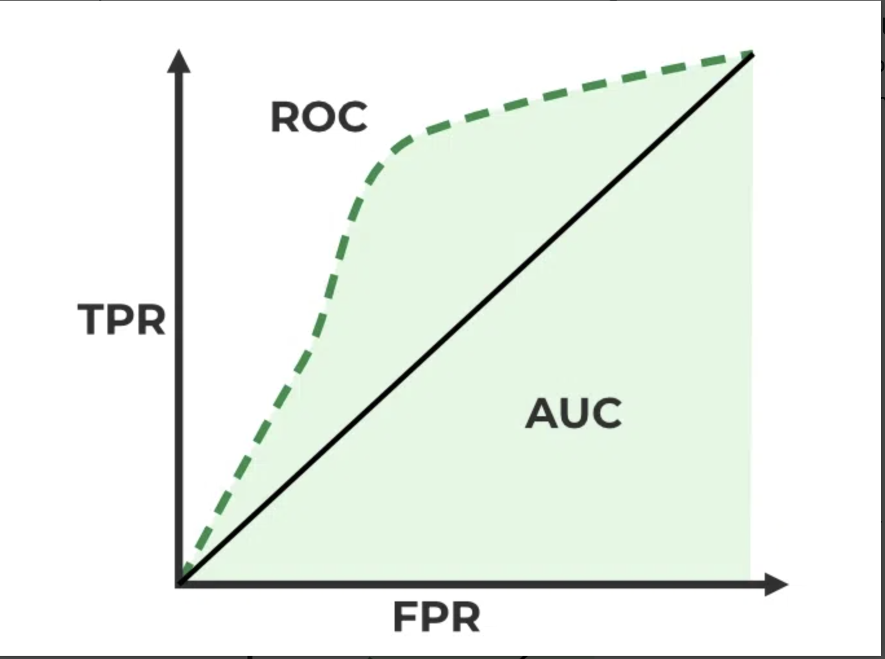
Proof Of Concept - Evaluation Metric
Primary Metric: ROC AUC
ROC AUC (Receiver Operating Characteristic Area Under Curve) measures each model’s ability to discriminate between edible and poisonous mushrooms, capturing both sensitivity and specificity.
Additional metrics, such as Recall and Precision, are reported to evaluate the trade-off between false positives and false negatives, ensuring models are both accurate and reliable.

Slide 16
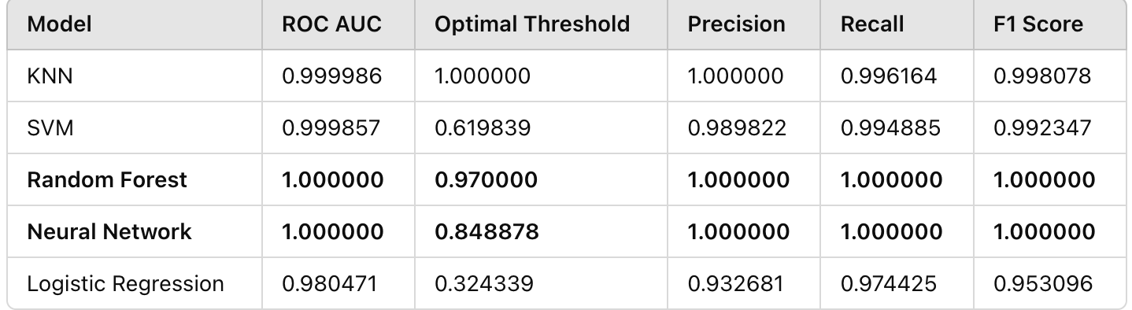
Proof Of Concept - Algorithm Selection

Slide 17
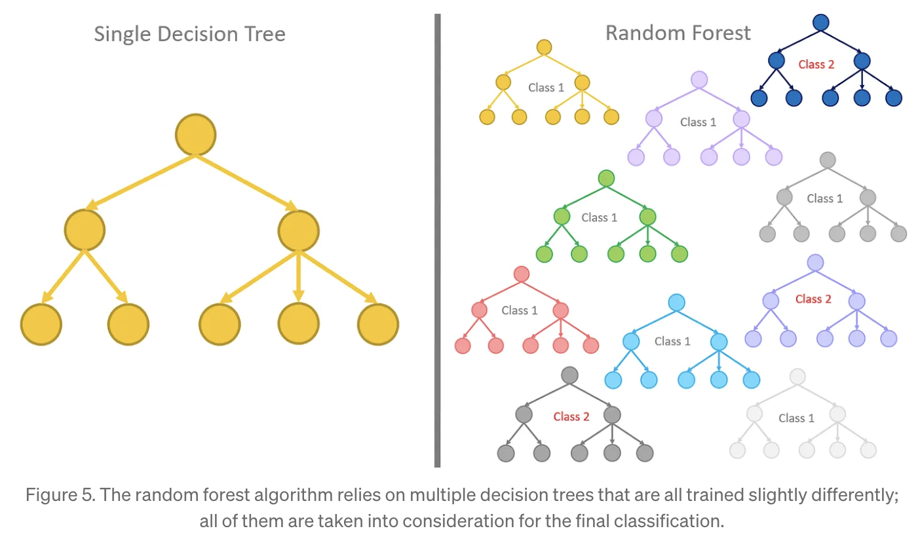
Proof Of Concept - Algorithm Selection
Algorithm Selection:
After running the evaluations, the Random Forest and Neural Network models stood out for their high ROC AUC scores and precision-recall balance, making them well-suited for this classification task. The Random Forest model was ultimately selected for its interpretability, efficient computation, and consistent performance. The Neural Network model was noted as a potential option for future iterations or larger datasets due to its ability to capture complex patterns.

Slide 18
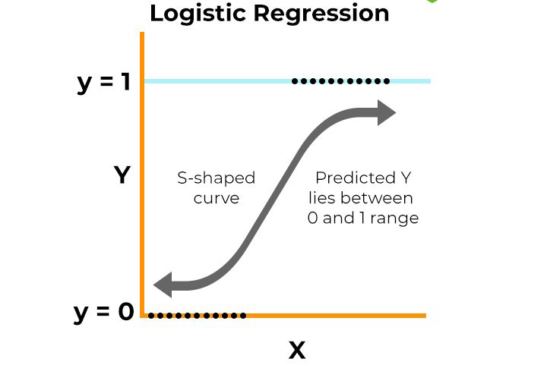
Baseline Algorithm - Logistic Regression
Type: Supervised Learning, Classification Algorithm
Purpose: Predicts the probability that an input belongs to a particular class
Output: Probability between 0 and 1, converted to class labels (e.g., 0 for edible, 1 for poisonous)
Key Steps in Logistic Regression for Classification
Step 1: Input features (X) are multiplied by coefficients to create a linear combination
Step 2: Apply the logistic (sigmoid) function to the linear combination to get probabilities
Step 3: Convert probability to class label based on a threshold (e.g., 0.5 by default)
Advantages
Simple to implement, interpret, and fast to compute
Useful for establishing a baseline for model comparison
Why Use Logistic Regression as a Baseline?
Easy interpretability allows us to understand data relationships quickly
Low computational cost provides fast preliminary insights
Sets a performance benchmark for comparing more complex models

Slide 19
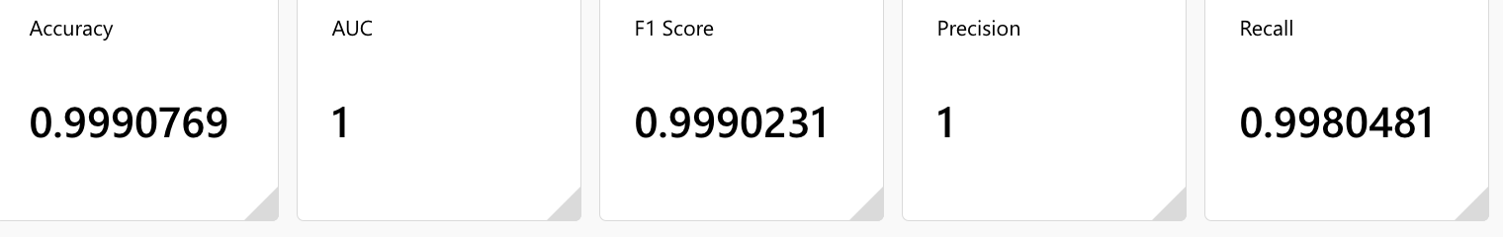
Logistic Regression - Metrics
The provided metrics indicate that the model is performing exceptionally well on the given dataset. It has achieved near-perfect accuracy, precision, recall, and AUC. This suggests that the model is highly effective in distinguishing between positive and negative classes.

Slide 20
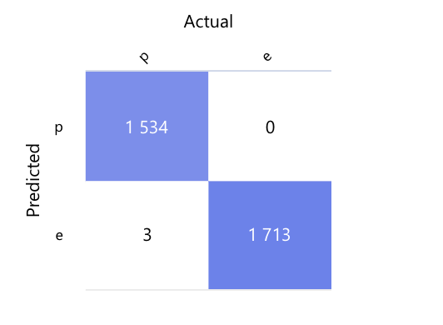
Logistic Regression - Confusion Matrix
Breakdown:
True Positives (TP): 1534. The model correctly identified 1534 poisonous mushrooms.
False Positives (FP): 0. The model didn't incorrectly identify any edible mushrooms as poisonous.
False Negatives (FN): 3. This is the concerning part. The model incorrectly identified 3 poisonous mushrooms as edible.
True Negatives (TN): 1713. The model correctly identified 1713 edible mushrooms.
Problem:
The 3 false negatives are the most critical issue. These are instances where the model predicted a mushroom to be edible when it was actually poisonous. This could lead to serious consequences if people rely on the model's predictions.
Solution:
Using more complex models like Random Forest to identify the correct poisonous mushrooms

Slide 21
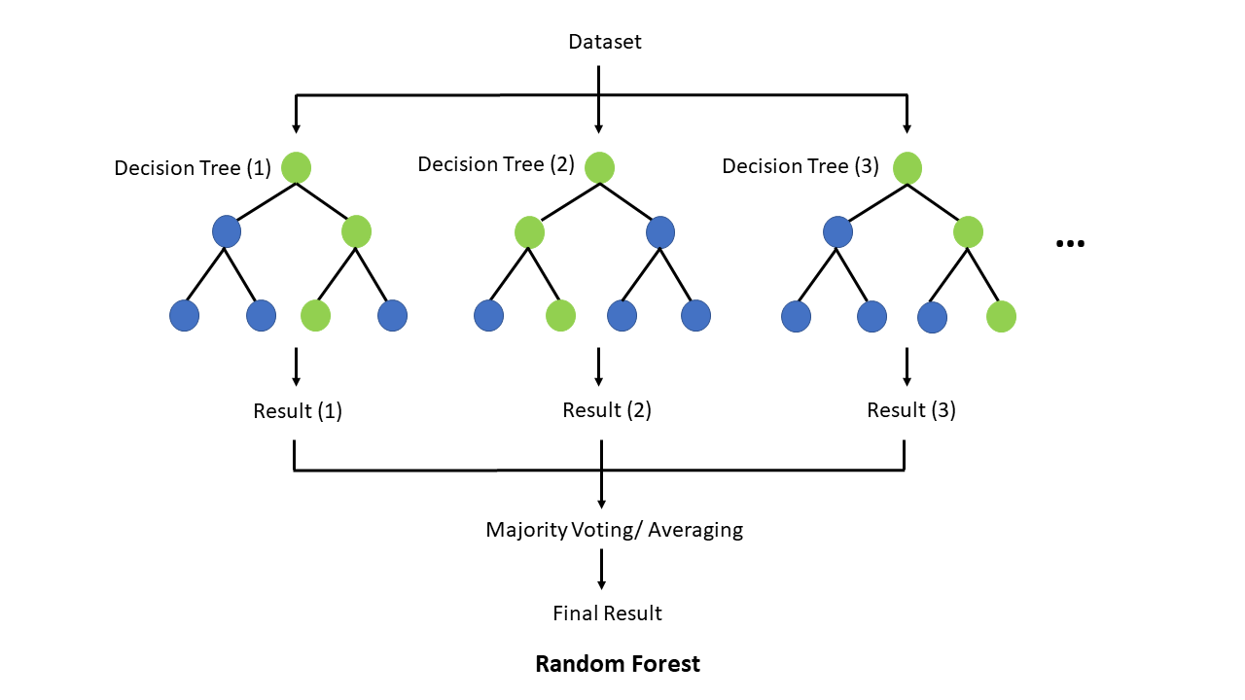
Final Algorithm - Random Forest
Type: Supervised & Ensemble Learning, Classification & Regression Algorithm
Purpose: ensemble of decision trees in which each decision tree is trained with a set of random training data.
Output: For classification tasks, the output of the random forest is the class selected by most trees.
Key Steps in RF for Classification
Step 1: Select random samples from a given data or training set.
Step 2: Construct a decision tree for every training data.
Step 3: Voting will take place by averaging the decision tree.
Step4: Finally, select the most voted prediction result as the final prediction result.
Advantages
Robustness and Stability: Random Forests aggregate multiple trees, improving model stability and reducing variance and eliminating overfitting and bias.
Feature Importance: Identifying which features (e.g., cap color, odor, gill color) most strongly indicate toxicity can aid in interpretability and further research.
Handling Categorical Variables: The mushroom dataset is mostly categorical, and Random Forests are naturally suited to this data type without needing extensive preprocessing.
Why we chose RF as the final and best algorithm to use to train our model?
Compared to other algorithms that we tested, RF gave us the best Recall score and Zero False Negatives. RF is computationally lighter algorithm than Neural Networks, hence using less resources and cost effective.
Notes:
False negative is the mushrooms that are not edible but the model predicts as edible.

Slide 22
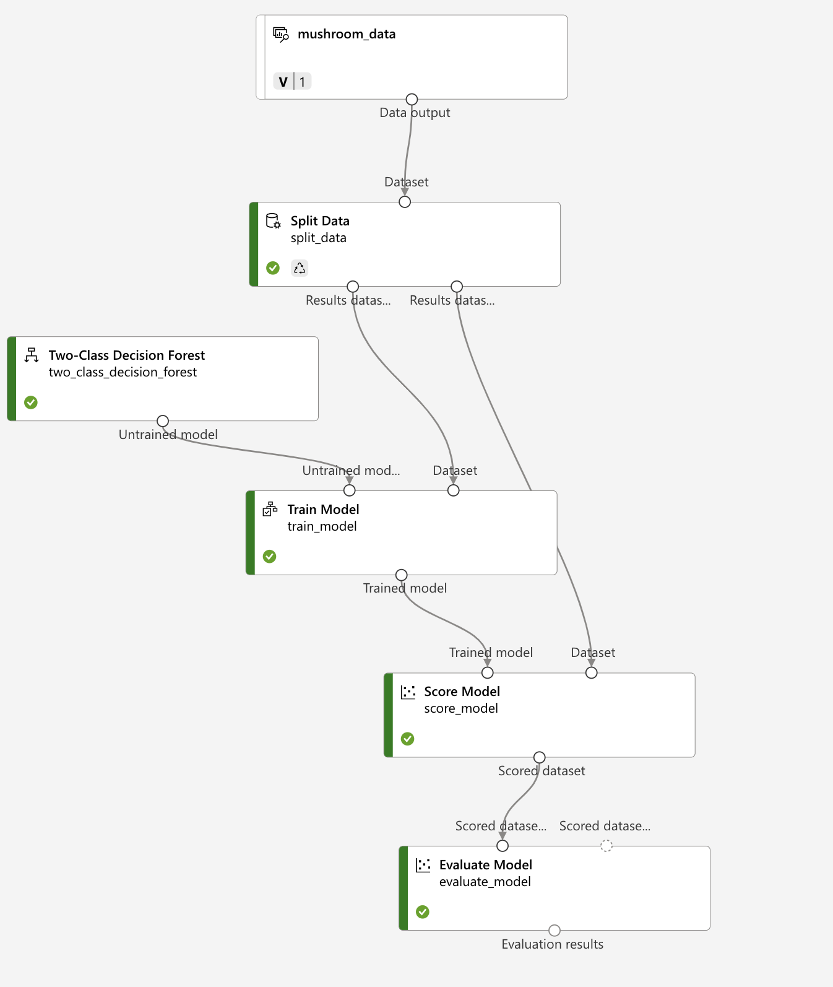
Final algorithm - Random Forest Pipeline

Slide 23
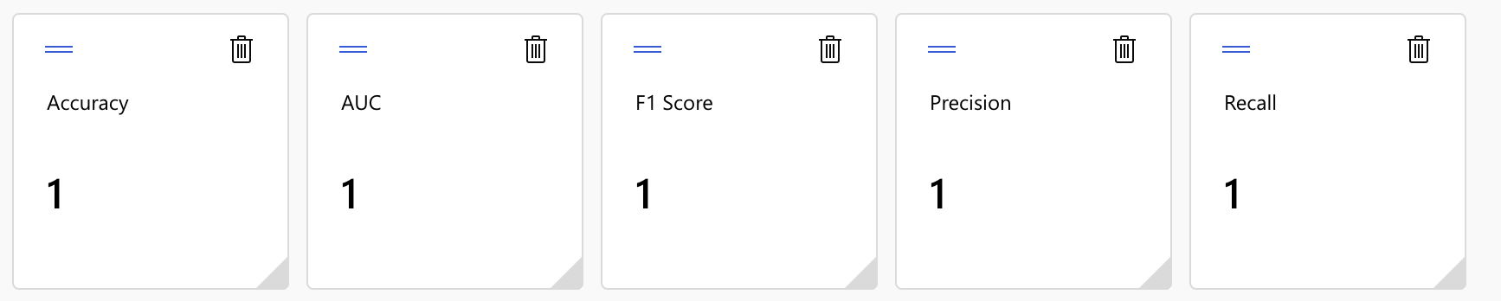
Final Algorithm - Random Forest
We split our data into 60% to train the model on, and 40% of data to test the model.
The above is the result from the test of our trained model using Two-class decision forest algorithm.
One is the perfect score and highest possible.
Compared to other algorithms, this algorithms worked the best.

Slide 24
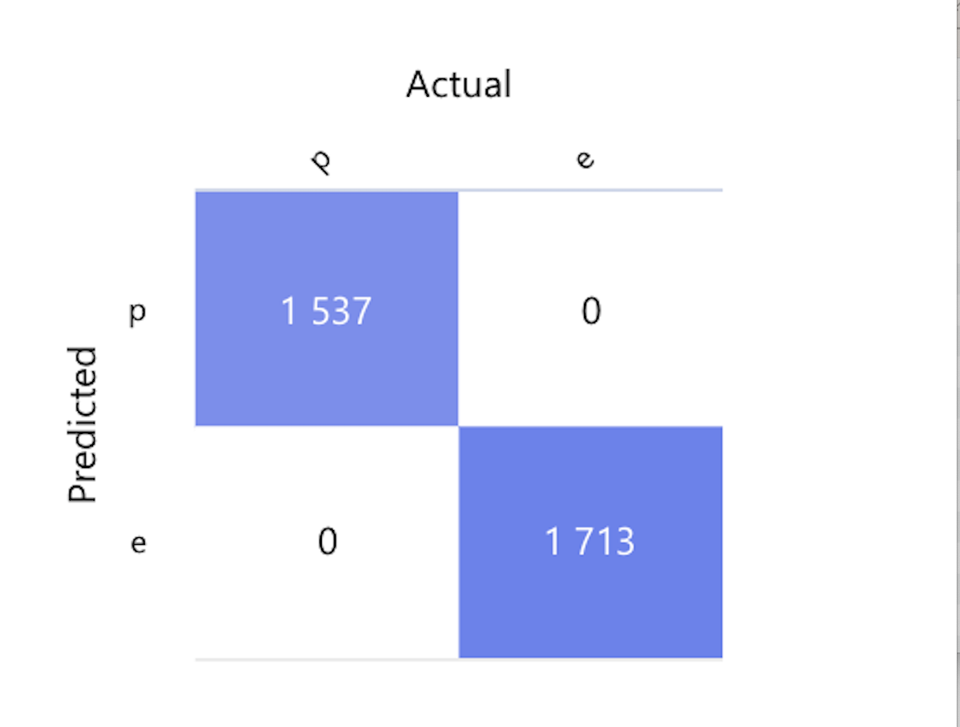
Random Forest - Confusion Matrix
As we see, we don’t have the problem of false negatives that we had with Linear Regression Algorithm.
1,713 mushrooms were predicted as edible in the testing of the model, and all 1,713 were edible. Hence, no false negatives.
This was important to us from the start since we are dealing with people’s lives and even one mushroom predicted edible that actually is not edible was not acceptable for us.
Note: We set poisonous as one or positive, and edible as 0 or negative in the mode.

Slide 25
Endpoint Demo

Slide 26
Random Forest - Confidence Scores
Random forests can provide a measure of confidence in their predictions through the aggregation of “votes” cast by their constituent trees.
Forest-Level Aggregation: The random forest aggregates predictions across all trees in the forest. The predictions from all trees are averaged to produce the final class probabilities. For example suppose our random forest consists of 100 trees. If 70 predicted that a given mushroom was poisonous and 30 trees predicted that it was edible, then the RF would predict the mushroom is poisonous with a confidence of: C(poisonous) = 70 / (70 + 30) = 0.7

Slide 27
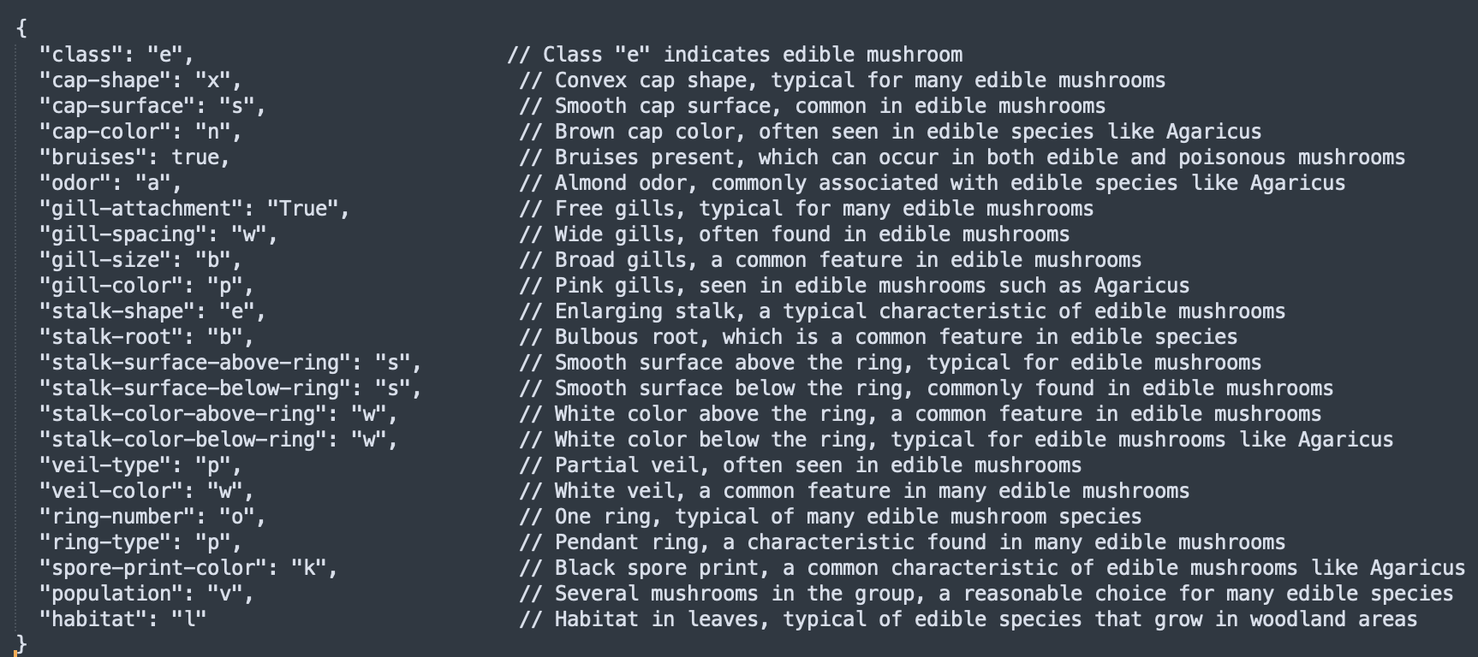
Mushroom Edibility Confident Score at 25 %

Slide 28
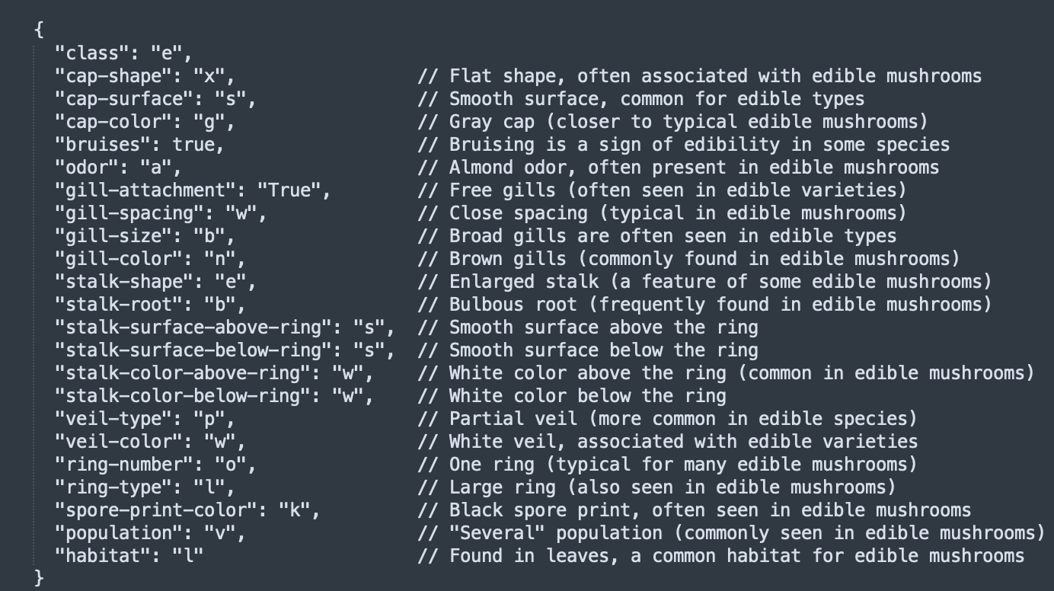
Mushroom Edibility Confident Score at 50 %

Slide 29
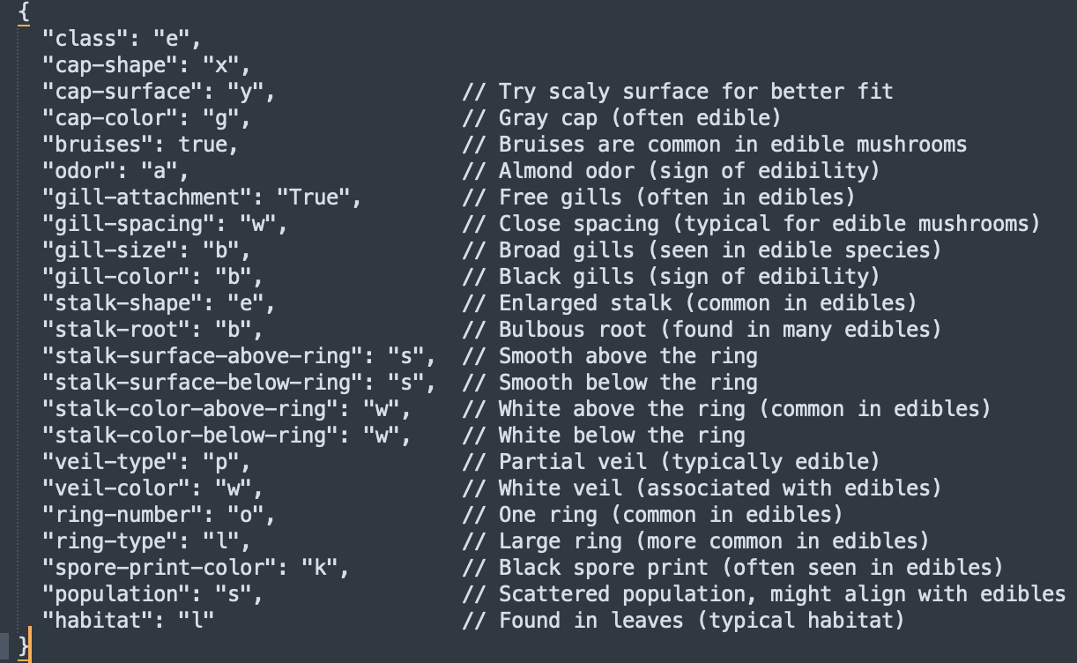
Mushroom Edibility Confident Score greater than 50 %

Slide 30
Conclusion
Our model is trying to predict based on mushroom features such as cap shape and size to predict that the mushroom is edible or poisonous.
If one mushroom predicted edible by the model, was poisonous, this could be deadly.
We have no room for false negatives (poisonous mushrooms deemed edible), because human lives are at stake.
After trying different algorithms on our data, Random Forest was found to give best results with our data.
Decision forests are fast, supervised ensemble models. This component is a good choice if you want to predict a target with a maximum of two outcomes.1

Slide 31
Conclusion
- After training our model with 60% of our data set and using Two class Decision Forest, perfect scores were obtained.
- We used 40% of the dataset to test our model. (3,250 rows of data)
- Our model has zero false negatives
- This means all the mushrooms that were predicted edible by our model, were actually edible.
- Zero mushrooms that were predicted by our model as edible, were poisonous.
- Not risking lives

Slide 32
Personal Observations
- Microsoft Azure ML Studio is a user-friendly, easy to use, and at the same time powerful platform to train and test machine learning models.
- No coding required with ML Studio, Everyone can learn this easy to use tool to perform complex machine learning without any coding experience.
- ML Studio provides a cost effective way for ML projects with no limits to the scalability.

Slide 33
Mushroom Classification Project Endpoint
- REST Endpoint:
http://104.42.221.145:80/api/v1/service/mushroomservice/score
- Swagger Documentation:
http://104.42.221.145/api/v1/service/mushroomservice/swagger.json

Slide 34
References
Random Forest
https://learn.microsoft.com/en-us/azure/machine-learning/component-reference/two-class-decision-forest?view=azureml-api-2
Data
https://www.kaggle.com/datasets/uciml/mushroom-classification

Slide 35

Mushrooms Yay!!!

